Slide 1
Chapter 3: Introduction to SQL
Notes:
SQL(Structured Query Language) 是关系数据库标准语言,包括数据定义、数据操纵、数据控制一体化管理功能。SQL是一种陈述式的语言。讲授SQL的表定义，包括：SQL基本数据类型、primary key、foreign key和check定义，以及SQL DML语句的基本用法，包括select、from、where、group by、having各子句。

Slide 2
Outline
Overview of the SQL Query Language
Data Definition
Basic Query Structure
Additional Basic Operations
Set Operations
Null Values
Aggregate Functions
Nested Subqueries
Modification of the Database
Notes:
1

Slide 3
Data Definition Language
The SQL data-definition language (DDL)定义语言 allows the specification of information about relations, including:
The schema for each relation.
The domain of values associated with each attribute.
Integrity constraints
And as we will see later, also other information such as
  The set of indices to be maintained for each relations.
  Security and authorization information for each relation.
  The physical storage structure of each relation on disk.

Slide 4
数据类型
同内容的char和varchar比较不一定相同，建议都定义成varchar
char(n). 定长为n的字符串.
varchar(n). 不定长字符串，不足n后面空格填充（没有结束标志‘\0’）
int. Integer (a finite subset of the integers that is machine-dependent).
smallint. Small integer (a machine-dependent subset of the integer domain type).
numeric(p,d). p有效位数，d小数点
→ number(3,1) allows 44.5 to be store exactly, but neither 444.5 or 0.32
real, double precision. Floating point and double-precision floating point numbers, with machine-dependent precision.
float(n). Floating point number, with user-specified precision of at least n digits.

Slide 5
date: Dates, containing a (4 digit) year, month and date
  Example: date ‘2005-7-27’
time: Time of day, in hours, minutes and seconds.
  Example: time ‘09:00:30’ time ‘09:00:30.75’
Timestamp时间戳: date plus time of day
  Example: timestamp ‘2005-7-27 09:00:30.75’
interval: period of time
  Example: interval ‘1’ day
  两个 date/time/timestamp 做差
  Interval values can be added to date/time/timestamp values
  date, time functions:
  current_date(), current_time() 取出当前时间
  year(x), month(x), day(x), hour(x), minute(x), second(x) 取出year，month等等

Slide 6
Create Table Construct
An SQL relation is defined using the create table command:
create table r (A₁ D₁, A₂ D₂, ..., A_{n} D_{n},
(integrity-constraint₁),
...,
(integrity-constraint_{k}))
  r is the name of the relation
  each A_{i} is an attribute name in the schema of relation r
  D_{i} is the data type of values in the domain of attribute A_{i}
Example:
create table instructor (
ID char(5),
name varchar(20) not null,
dept_name varchar(20),
salary numeric(8,2))
insert into instructor values (‘10211’, ’Smith’, ’Biology’, 66000);
insert into instructor values (‘10211’, null, ’Biology’, 66000);
完整性约束
插入失败

Slide 7
Integrity Constraints in Create Table
not null
primary key (A₁, ..., A_{n} )
foreign key (A_{m}, ..., A_{n} ) references r
Example: Declare ID as the primary key for instructor
.
create table instructor (
ID char(5),
name varchar(20) not null,
dept_name varchar(20),
salary numeric(8,2),
primary key (ID),
foreign key (dept_name) references department)
primary key 会自动保证 not null，并且唯一

Slide 8


create table student (
ID varchar(5),
name varchar(20) not null,
dept_name varchar(20),
tot_cred numeric(3,0) default 0，
primary key (ID),
foreign key (dept_name) references department) );
create table takes (
ID varchar(5),
course_id varchar(8),
sec_id varchar(8),
semester varchar(6),
year numeric(4,0),
grade varchar(2),
primary key (ID, course_id, sec_id, semester, year),
foreign key (ID) references student,
foreign key (course_id, sec_id, semester, year) references section );
  Note: sec_id 如果去掉，则一个学生不能同时选1个以上sec

Slide 9
create table course (
course_id varchar(8) primary key,
title varchar(50),
dept_name varchar(20),
credits numeric(2,0),
foreign key (dept_name) references department (dept_name));
foreign key (dept_name) references department)
  on delete cascade 连锁，一起删|set null |restrict(或称为none action 不准删) |set default
on update cascade 连锁，一起更新 |set null |restrict |set default,
这么写也行
有时候要求把这个也写出来
外键更新时指定,引用的行的值
teaches
ID
course_id
instructor
Prime key的动作就不能选择set null
10101
12121
76766
CS-101
FIN-201
BIO-101
ID
name
dept_name
10101
12121
76766
Srinivasan
Wu
Mozart
Comp. Sci.
Finance
Music

Slide 10
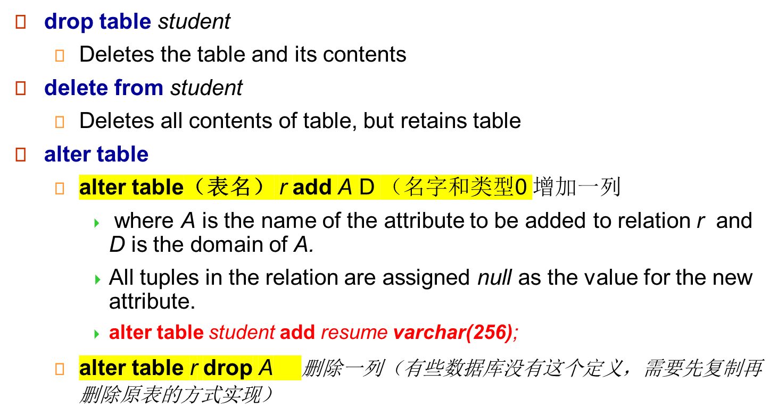
Drop and Alter Table Constructs

Slide 11
*SQL and Relational Algebra
select A1, A2, .. An
from r1, r2, …, rm
where P
is equivalent to the following expression in multiset relational algebra
∏ _{A1, .., An} (σ _{P} (r1 x r2 x .. x rm) )
投影出属性

Slide 12
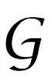
*SQL and Relational Algebra
select A1, A2, sum(A3)
from r1, r2, …, rm
where P
group by A1, A2
is equivalent to the following expression in multiset relational algebra
_{A1, A2} _{sum(A3)} (σ _{P} (r1 x r2 x .. x rm)))

Slide 13
*SQL and Relational Algebra
More generally, the non-aggregated attributes in the select clause may be a subset of the group by attributes, in which case the equivalence is as follows:
select A1, sum(A3)
from r1, r2, …, rm
where P
group by A1, A2
is equivalent to the following expression in multiset relational algebra
∏ _{A1,sumA3}( _{A1,A2} _{sum(A3)} _{as sumA3}(σ _{P} (r1 x r2 x .. x rm)))

Slide 14
Basic Query Structure
The SQL data-manipulation language (DML) provides the ability to query information, and insert, delete and update tuples
A typical SQL query has the form:
select A₁, A₂, ..., A_{n}
from r₁, r₂, ..., r_{m}
where P
  A_{i} represents an attribute
  R_{i} represents a relation
  P is a predicate.
The result of an SQL query is a relation.
Notes:
2

Slide 15
The select Clause
The select clause list the attributes desired in the result of a query
  corresponds to the projection operation of the relational algebra
Example: find the names of all instructors:
select name
from instructor
NOTE: SQL names（SQL语句，属性) are case insensitive 大写不敏感（大小写一样），但大小值是敏感的
  E.g. Name ≡ NAME ≡ name
  Some people use upper case wherever we use bold font.
Notes:
3

Slide 16
The select Clause (Cont.)
SQL allows duplicates in relations as well as in query results.
To force the elimination of duplicates, insert the keyword distinct after select.
Find the names of all departments with instructor, and remove duplicates
select distinct dept_name
from instructor
The keyword all specifies that duplicates not be removed.
select all dept_name
from instructor
一种只出现一次，去重
Notes:
4

Slide 17
The select Clause (Cont.)
所有属性选择出来
select *
from instructor
The select clause can contain arithmetic expressions involving the operation, +, –, ∗, and /, and operating on constants or attributes of tuples.还可以投影算术表达式
The query:
select ID, name, salary/12
from instructor
would return a relation that is the same as the instructor relation, except that the value of the attribute salary is divided by 12.
Notes:
5

Slide 18
The where Clause
The where clause specifies conditions that the result must satisfy
  Corresponds to the selection predicate of the relational algebra.
To find all instructors in Comp. Sci. dept with salary > 80000 select name
from instructor
where dept_name = ‘Comp. Sci.' and salary > 80000
Comparison results can be combined using the logical connectives and, or, and not.
Comparisons can be applied to results of arithmetic expressions.
Notes:
6

Slide 19
Where Clause Predicates
SQL includes a between comparison operator
Example: Find the names of all instructors with salary between $90,000 and $100,000 (that is, ≥ $90,000 and ≤ $100,000)
  select name
  from instructor
  where salary between 90000 and 100000
Tuple comparison
  select name, course_id
  from instructor, teaches
  where (instructor.ID, dept_name) = (teaches.ID, ’Biology’);
元组的直接比较，每个属性分别相等
Notes:
7

Slide 20
The from Clause
The from clause lists the relations involved in the query
  Corresponds to the Cartesian product 笛卡儿积
Find the Cartesian product instructor X teaches
select ∗
from instructor, teaches
  generates every possible instructor – teaches pair, with all attributes from both relations
Notes:
8

Slide 21

Joins
For all instructors who have taught some course, find their names and the course ID of the courses they taught.
select name, course_id
from instructor, teaches
where instructor.ID = teaches.ID
Find the course ID, semester, year and title of each course offered by the Comp. Sci. department
select section.course_id, semester, year, title
from section, course
where section.course_id = course.course_id and
dept_name = ‘Comp. Sci.'

Slide 22

Natural Join
Natural join matches tuples with the same values for all common attributes, and retains only one copy of each common column
select * from instructor natural join teaches;
自然连接
  instructor(ID,name,dept_name,salary）
  teaches( ID, course_id,sec_id,semester, year)

Slide 23
Natural Join (Cont.)
Beware of unrelated attributes with same name which get equated incorrectly
List the names of instructors along with the titles of courses that they teach
    course(course_id,title, dept_name,credits）
    teaches( ID, course_id,sec_id,semester, year)
    instructor(ID,name, dept_name,salary）
  Incorrect version (makes course.dept_name = instructor.dept_name)
    select name, title
    from instructor natural join teaches natural join course;
  Correct version
    select name, title
    from instructor natural join teaches, course
    where teaches.course_id = course.course_id;
    select name, title
    from (instructor natural join teaches）join course using(course_id);
    select name, title
    from instructor，teaches, course
    where instructor.ID=teaches .ID and teaches.course_id =course.course_id;
这两个dept_name含义不同
先natural join，再用where来join

Slide 24
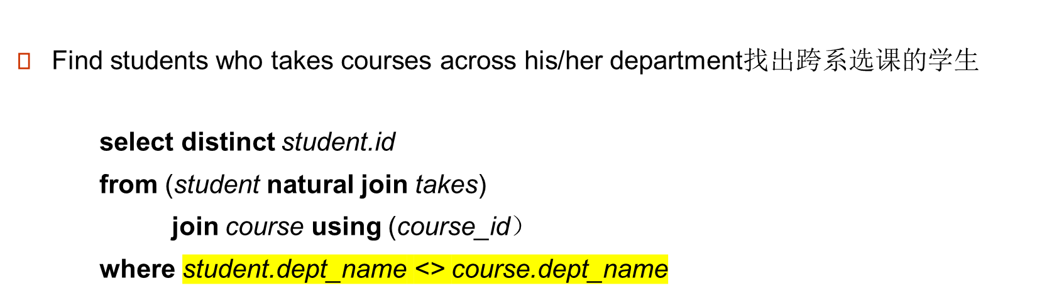

Natural Join Another Example
student( ID, name, dept_name, tot_cred )
takes ( ID, course_id, sec_id, semester,year.grade)
course( course_id, title, dept_name, credits）

Slide 25
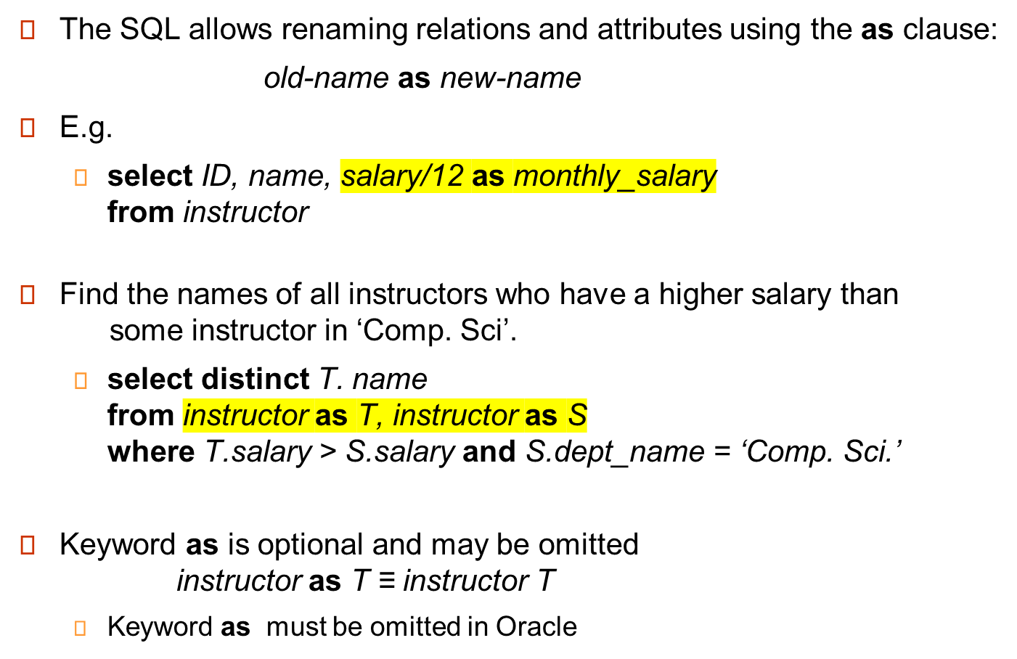
The Rename Operation
重命名
同一个表相乘
Notes:
9

Slide 26
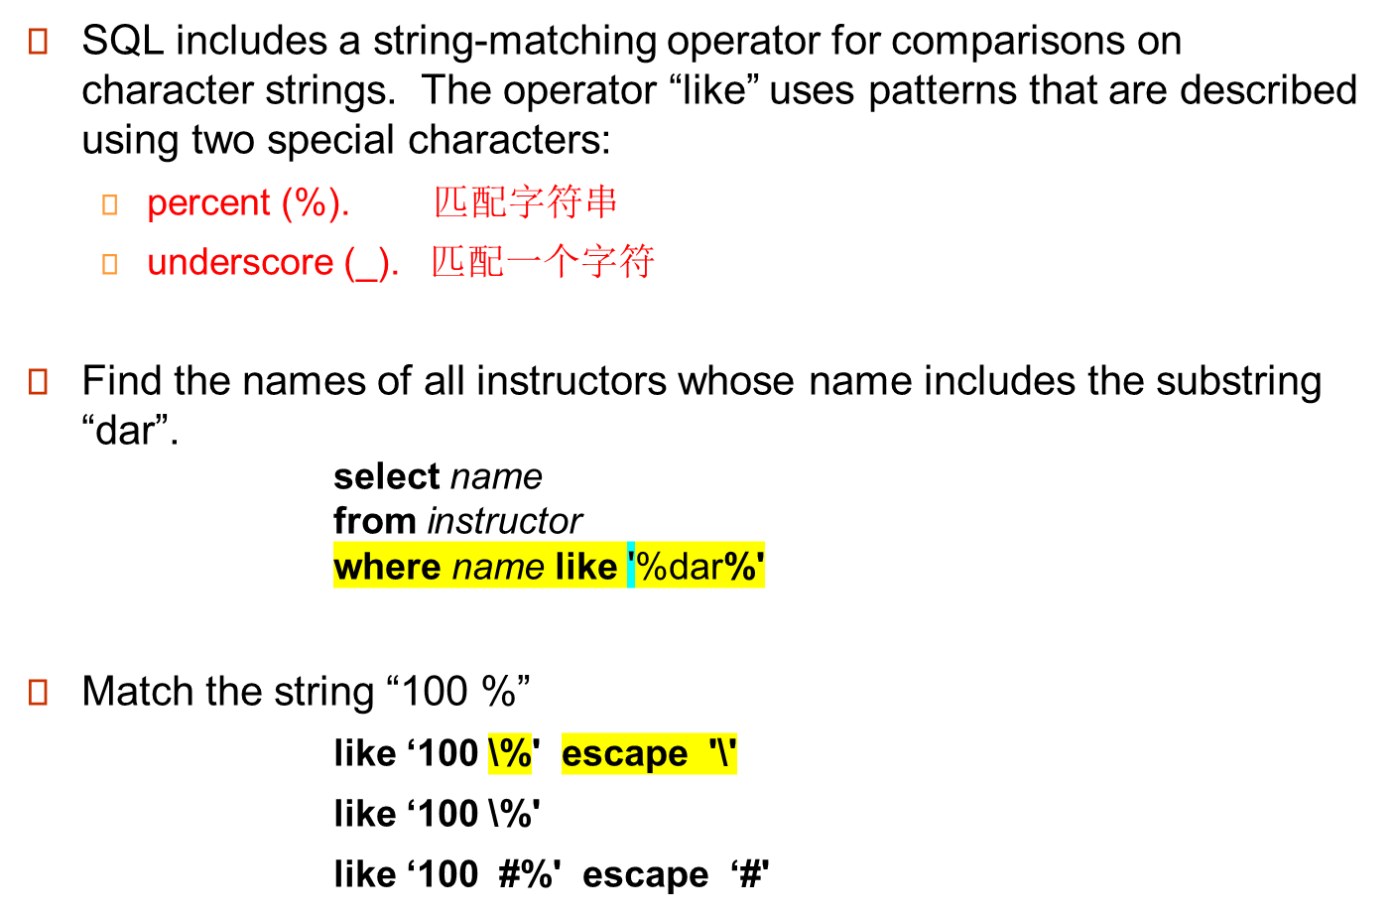
String Operations
单引号表示字符串
找’%张%’
可能查找的结果里面不出现张（和字符串编码有关系）
\是转意字符
#是转意字符

Slide 27
String Operations
Patters are case sensitive.
Pattern matching examples:
  ‘Intro%’ matches any string beginning with “Intro”.
  ‘%Comp%’ matches any string containing “Comp” as a substring.
  ‘_ _ _’ matches any string of exactly three characters.
  ‘_ _ _ %’ matches any string of at least three characters.
SQL supports a variety of string operations such as
  concatenation (using “||”)
  converting from upper to lower case (and vice versa)
  finding string length, extracting substrings, etc.

Slide 28
Ordering the Display of Tuples 显示出来是有序的
List in alphabetic order the names of all instructors
select distinct name
from instructor
order by name
We may specify desc for descending(降) order or asc for ascending（升） order, for each attribute; ascending order is the default.
  Example: order by name desc
Can sort on multiple attributes
  Example: order by dept_name, name
按name的顺序展示
先按照dept_name，再按照name

Slide 29

The limit Clause
The limit clause can be used to constrain the number of rows returned by the select statement.
limit clause takes one or two numeric arguments, which must both be nonnegative integer constants:
  limit offset, row_count
  limit row_count == limit 0, row_count
List names of instructors whose salary is among top 3.
select name
from instructor
order by salary desc
limit 3； // limit 0,3
取排序种的前三个/
Notes:
7

Slide 30
Duplicates
In relations with duplicates, SQL can define how many copies of tuples appear in the result.
Multiset（多重集） versions of some of the relational algebra operators – given multiset relations r₁ and r₂:
  1. σ_{θ} (r₁): If there are c₁ copies of tuple t₁ in r₁, and t₁ satisfies selections σ_{θ,}, then there are c₁ copies of t₁ in σ_{θ} (r₁).
  2. Π_{A} (r ): For each copy of tuple t₁ in r₁, there is a copy of tuple Π_{A} (t₁) in Π_{A} (r₁) where Π_{A} (t₁) denotes the projection of the single tuple t₁.
  3. r₁ x r₂ : If there are c₁ copies of tuple t₁ in r₁ and c₂ copies of tuple t₂ in r₂, there are c₁ x c₂ copies of the tuple t₁. t₂ in r₁ x r₂

Slide 31

Duplicates (Cont.)
Example: Suppose multiset relations r₁ (A, B) and r₂ (C) are as follows:
r₁ = {(1, a) (2,a)} r₂ = {(2), (3), (3)}
Π_{B}(r₁) = {(a), (a)}
Π_{B}(r₁) x r₂ =
{(a,2), (a,2), (a,3), (a,3), (a,3), (a,3)}
SQL duplicate semantics:
select A₁,, A₂, ..., A_{n}
from r₁, r₂, ..., r_{m}
where P
is equivalent to the multiset version of the expression:

Slide 32
Set Operations
Find courses that ran in Fall 2009 or in Spring 2010
(select course_id from section where sem = ‘Fall’ and year = 2009)
union 去重的集合操作
(select course_id from section where sem = ‘Spring’ and year = 2010)
Find courses that ran in Fall 2009 and in Spring 2010
(select course_id from section where sem = ‘Fall’ and year = 2009)
intersect 相交
(select course_id from section where sem = ‘Spring’ and year = 2010)
Find courses that ran in Fall 2009 but not in Spring 2010
(select course_id from section where sem = ‘Fall’ and year = 2009)
except 去除
(select course_id from section where sem = ‘Spring’ and year = 2010)

Slide 33
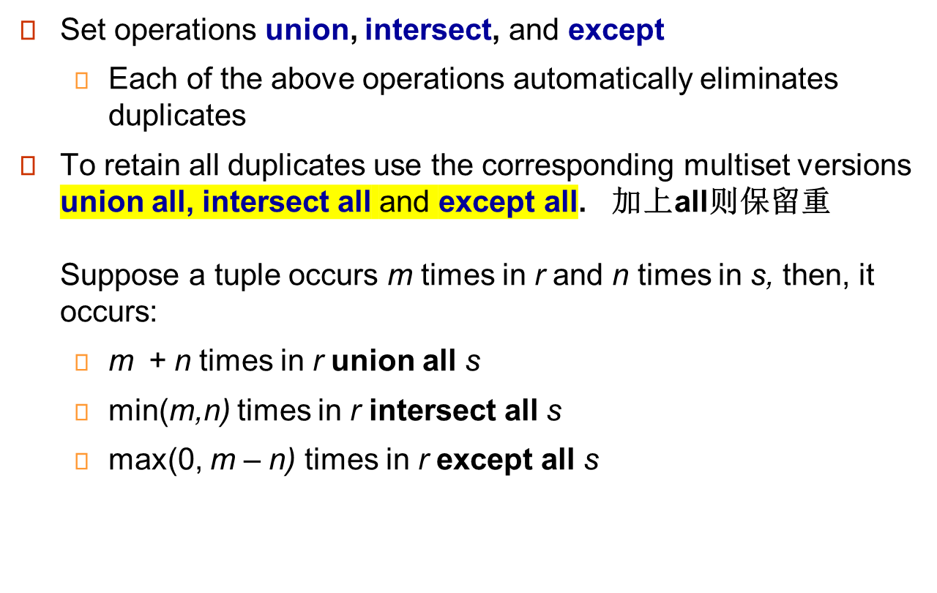
Set Operations

Slide 34
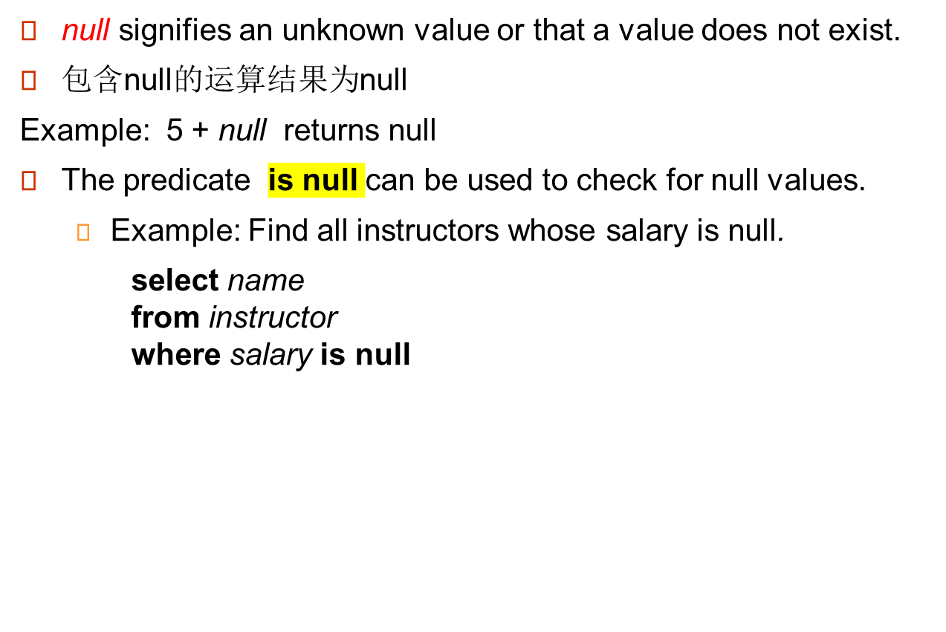
Null Values

Slide 35
Null Values
与空值比较返回特殊的真值:unknown
Three-valued logic using the truth value unknown:
  OR: (unknown or true) = true,
  (unknown or false) = unknown
  (unknown or unknown) = unknown
  AND: (true and unknown) = unknown,
  (false and unknown) = false,
  (unknown and unknown) = unknown
  NOT: (not unknown) = unknown
  In SQL “P is unknown” evaluates to true if predicate P evaluates to unknown
Result of select predicate is treated as false if it evaluates to unknown

Slide 36
Aggregate Functions
These functions operate on the multiset of values of a column of a relation, and return a value
avg: average value
min: minimum value
max: maximum value
sum: sum of values
count: number of values

Slide 37
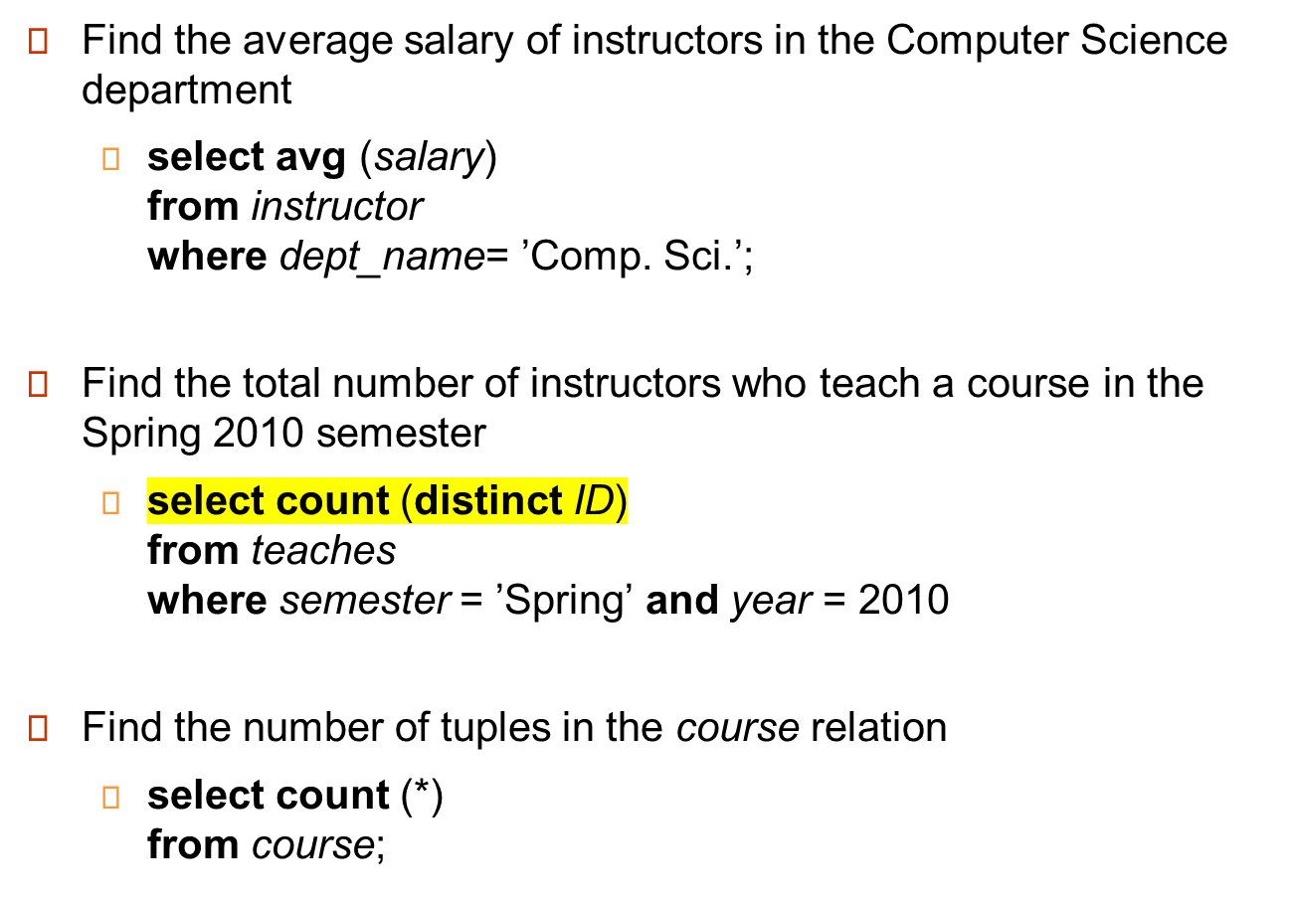

Slide 38


Aggregate Functions – Group By分组
Find the average salary of instructors in each department
  select dept_name, avg (salary) as avg_salary
  from instructor
  group by dept_name;
  Note: departments with no instructor will not appear in result

Slide 39
Attributes in select clause outside of aggregate functions must appear in group by list
  /* erroneous query */
  select dept_name, ID, avg (salary)
  from instructor
  group by dept_name;
错误， select中的值都必须在group by中出现过

Slide 40
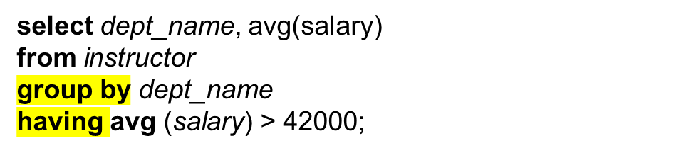
Aggregate Functions – Having Clause过滤
Find the names and average salaries of all departments whose average salary is greater than 42000
Where是分组之前，having是分组之后对组进行过滤
Note: predicates in the having clause are applied after the
formation of groups whereas predicates in the where
clause are applied before forming groups
select dept_name, count (*) as cnt
from instructor
where salary >=100000
group by dept_name
having count (*) > 10
order by cnt;
高薪老师个数大于10的院系的老师排序

Slide 41
Null Values and Aggregates
Total all salaries
select sum (salary )
from instructor
  Above statement ignores null amounts
  Result is null if there is no non-null amount
All aggregate operations except count(*) ignore tuples with null values on the aggregated attributes
What if collection has only null values?只有一个空值
  count returns 0
  all other aggregates return null 只能返回一个空
Aggregates自动忽略null

Slide 42
Arithmetric expression with Aggregate functions
没有充满学生
select dept_name
  from student
  group by dept_name
  having count(distinct name) = count(id)
  What is the meaning of the following statement ?
  select dept_name
  from student
  group by dept_name
  having 1-count(distinct name)/ count(id)<0.001 ;

Slide 43
Nested Subqueries嵌套查询
SQL provides a mechanism for the nesting of subqueries.
A subquery is a select-from-where expression that is nested within another query.
A common use of subqueries is to perform tests for :
  set membership
  set comparisons
  set cardinality
相当于多层循环

Slide 44
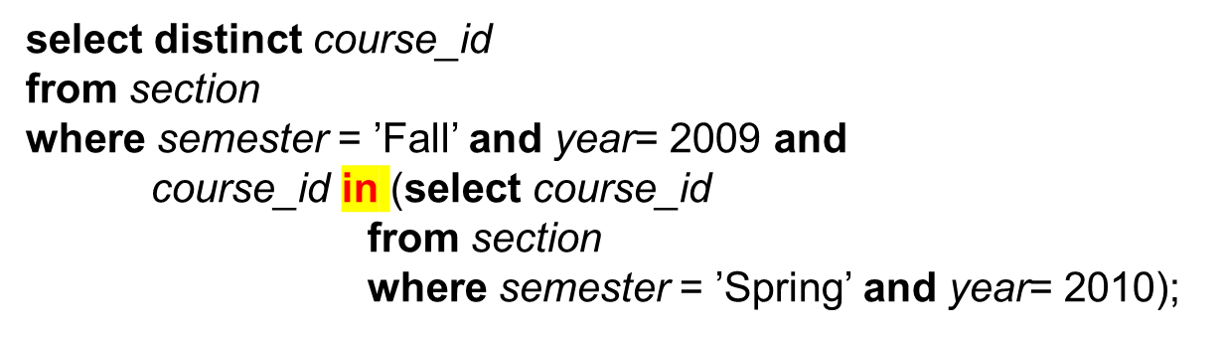

Set Membership
Find courses offered in Fall 2009 and in Spring 2010
Find courses offered in Fall 2009 but not in Spring 2010

Slide 45
Set Membership
Find the total number of (distinct) students who have taken course sections taught by the instructor with ID 10101
select count (distinct ID)
from takes
where (course_id, sec_id, semester, year) in
(select course_id, sec_id, semester, year
from teaches
where teaches.ID= ‘10101’);

Slide 46
Set Comparison
Find names of instructors with salary greater than that of some (at least one) instructor in the Biology department.
select distinct T.name
from instructor as T, instructor as S
where T.salary > S.salary and S.dept_name = ’Biology’;
Same query using > some clause
select name
from instructor
where salary > some (select salary
from instructor
where dept_name = ’Biology’);

Slide 47
Definition of Some Clause
F <comp> some r ⇔ ∃ t ∈ r such that (F <comp> t )
Where <comp> can be: <, ≤, >, =, ≠
0
(5 < some
5
) = true
(read: 5 < some tuple in the relation)
6
0
(5 < some
5
) = false
0
(5 = some
) = true
5
0
(5 ≠ some
5
) = true (since 0 ≠ 5)
(= some) ≡ in
However, (≠ some) ≡ not in

Slide 48
Set Comparison
Find the names of all instructors whose salary is greater than the salary of all instructors in the Biology department.
select name
from instructor
where salary > all (select salary
from instructor
where dept_name = ’Biology’);

Slide 49
Definition of all Clause
F <comp> all r ⇔ ∀ t ∈ r (F <comp> t)
0
(5 < all
5
) = false
6
6
(5 < all
) = true
10
4
(5 = all
) = false
5
4
(5 ≠ all
) = true (since 5 ≠ 4 and 5 ≠ 6)
6
(≠ all) ≡ not in
However, (= all) ≡ in

Slide 50
Scalar Subquery
Scalar（标量） subquery is one which is used where a single value is expected
E.g. select name
from instructor
where salary * 10 >
(select budget from department
where department.dept_name = instructor.dept_name)
Runtime error if subquery returns more than one result tuple
Skip to modification of datdabase
两层循环，instructor的值会传入第二层的instructor
此时子查询只返回一个值

Slide 51
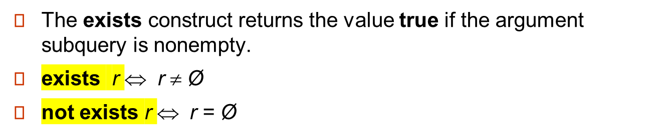

Test for Empty Relations

Slide 52
Correlation Variables
Yet another way of specifying the query “Find all courses taught in both the Fall 2009 semester and in the Spring 2010 semester”
select course_id
from section as S
where semester = ’Fall’ and year= 2009 and
exists (select *
from section as T
where semester = ’Spring’ and year= 2010
and S.course_id= T.course_id);
Correlated subquery
Correlation name or correlation variable

Slide 53
Not Exists
Find all students who have taken all courses offered in the Biology department.
select distinct S.ID, S.name
from student as S
where not exists ( (select course_id
from course
where dept_name = ’Biology’)
except
(select T.course_id
from takes as T
where S.ID = T.ID));
SQL中没有除法
生物系的课程 – 这个学生选的课程
Note that X – Y = Ø ⇔ X ⊆ Y
Note: Cannot write this query using = all and its variants

Slide 54
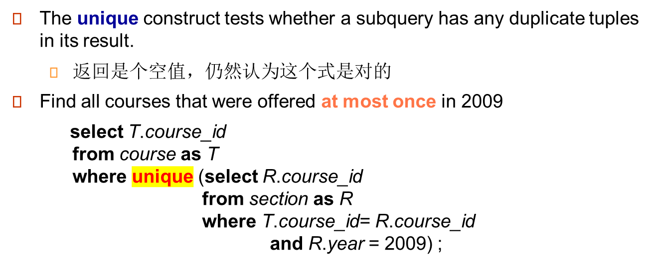
Test for Absence of Duplicate Tuples多重集
反一下就是
not unique

Slide 55
Test for Absence of Duplicate Tuples
Find all courses that were offered once in 2009 开过并且只开过一次
  select T.course_id
  from course as T
  where unique (select R.course_id
  from section as R
  where T.course_id= R.course_id
  and R.year = 2009)
  and exists (select R.course_id
  from section as R
  where T.course_id= R.course_id
  and R.year = 2009) ;
  Another solution:
  and course_id in (select course_id
  from section
  where year = 2009) ;
  ;

Slide 56
Test for Absence of Duplicate Tuples
Find all courses that were offered at most once in every semester 每个学期最多只开过一次
  select T.course_id
  from course as T
  where unique (select R.course_id, year, semester
  from section as R
  where T.course_id= R.course_id
  );
Find all courses that were offered once in every semester
  select T.course_id
  from course as T
  where unique (select R.course_id, year, semester
  from section as R
  where T.course_id= R.course_id
  )
  and exists (select R.course_id, year, semester
  from section as R
  where T.course_id= R.course_id
  );
having count(*)=1

Slide 57
*Subqueries in the From Clause
SQL allows a subquery expression to be used in the from clause
Find the average instructors’ salaries of those departments where the average salary is greater than $42,000.
  select dept_name, avg_salary
  from (select dept_name, avg (salary) as avg_salary
  from instructor
  group by dept_name)
  where avg_salary > 42000;
Another way to write above query
  select dept_name, avg_salary
  from (select dept_name, avg (salary)
  from instructor
  group by dept_name)
  as dept_avg (dept_name, avg_salary)
  where avg_salary > 42000;

Slide 58
*Subqueries in the From Clause (Cont.)
And yet another way to write it: lateral clause
  select name, salary, avg_salary
  from instructor I1,
  lateral (select avg(salary) as avg_salary
  from instructor I2
  where I2.dept_name= I1.dept_name);
Lateral clause permits later part of the from clause (after the lateral keyword) to access correlation variables from the earlier part.
Note: lateral is part of the SQL standard, but is not supported on many database systems; some databases such as SQL Server offer alternative syntax

Slide 59
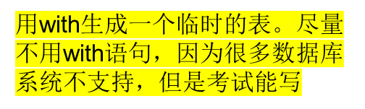
The with clause provides a way of defining a temporary view whose definition is available only to the query in which the with clause occurs.
Find all departments with the maximum budget
with max_budget (value) as
(select max(budget)
from department)
select dept_name
from department, max_budget
where department.budget = max_budget.value;
select dept_name
from department
where budget = (select (max(budget) from department))

Slide 60
*Complex Queries using With Clause
With clause is very useful for writing complex queries
Supported by most database systems, with minor syntax variations
Find all departments where the total salary is greater than the average of the total salary at all departments
with dept _total (dept_name, value) as
(select dept_name, sum(salary)
from instructor
group by dept_name),
dept_total_avg(value) as
(select avg(value)
from dept_total)
select dept_name
from dept_total, dept_total_avg
where dept_total.value >= dept_total_avg.value;

Slide 61
Modification of the Database
Deletion of tuples from a given relation 删除
Insertion of new tuples into a given relation 插入
Updating values in some tuples in a given relation 更新

Slide 62
Deletion 删除
Delete all instructors
delete from instructor
Delete all instructors from the Finance department
delete from instructor
where dept_name= ’Finance’;
Delete all tuples in the instructor relation for those instructors associated with a department located in the Watson building.
delete from instructor
where dept_name in (select dept_name
from department
where building = ’Watson’);

Slide 63
Delete all instructors whose salary is less than the average salary of instructors
delete from instructor
where salary< (select avg (salary) from instructor);
  Problem: as we delete tuples from deposit, the average salary changes
  Solution used in SQL:
  1. First, compute avg salary and find all tuples to delete
  2. Next, delete all tuples found above (without recomputing avg or
  retesting the tuples)

Slide 64
Insertion 插入
Add a new tuple to course
insert into course
values (’CS-437’, ’Database Systems’, ’Comp. Sci.’, 4);
or equivalently
insert into course (course_id, title, dept_name, credits)
values (’CS-437’, ’Database Systems’, ’Comp. Sci.’, 4);
Add a new tuple to student with tot_creds set to null
insert into student
values (’3003’, ’Green’, ’Finance’, null);

Slide 65
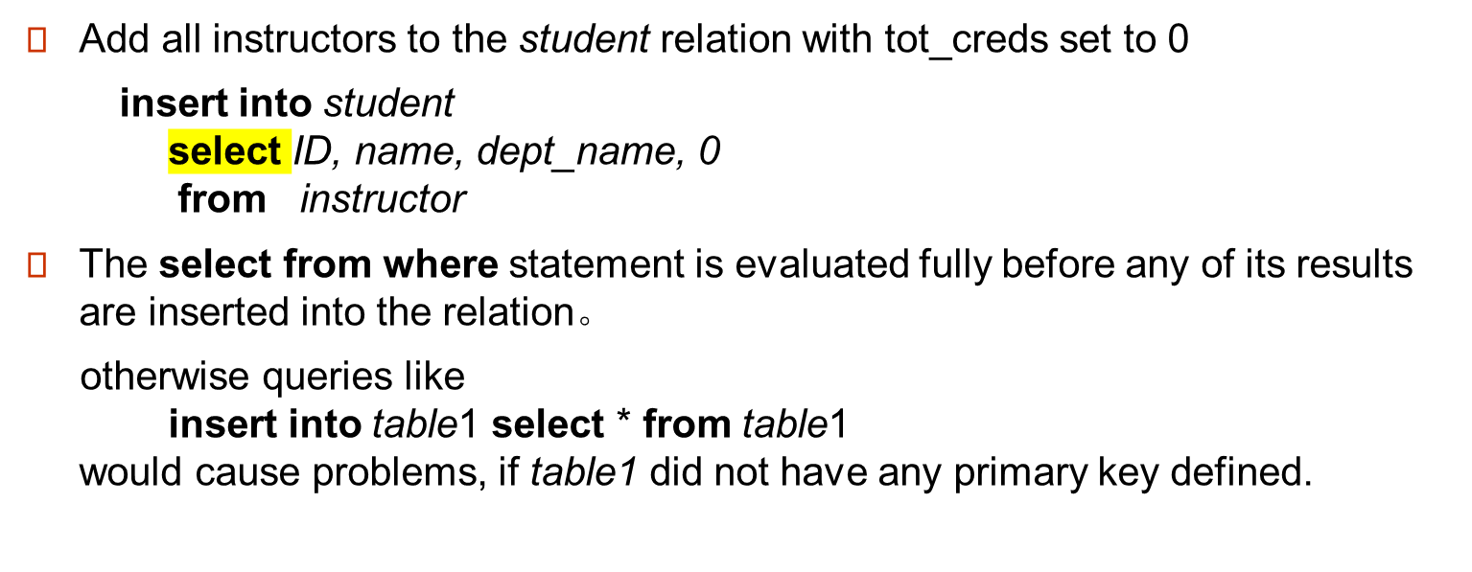
把查询结果插入表中

Slide 66
Updates 更新
Increase salaries of instructors whose salary is over $100,000 by 3%, and all others receive a 5% raise
  Write two update statements:
  update instructor
  set salary = salary * 1.03
  where salary > 100000;
  update instructor
  set salary = salary * 1.05
  where salary <= 100000;
  The order is important
  Can be done better using the case statement (next slide)

Slide 67
Case Statement for Conditional Updates
Same query as before but with case statement
update instructor
set salary = case
when salary <= 100000 then salary * 1.05
else salary * 1.03
end
按case，这就和顺序没关系

Slide 68
Updates with Scalar Subqueries
Recompute and update tot_creds value for all students
update student S
set tot_cred = ( select sum(credits)
from takes natural join course
where S.ID= takes.ID and
takes.grade <> ’F’ and
takes.grade is not null);
Sets tot_creds to null for students who have not taken any course
Instead of sum(credits), use:
case
when sum(credits) is not null then sum(credits)
else 0
end

